Slide 1
INSIGHTS INTO LIFE THROUGH ENGLISH LITERATURE
S.ABHISHEK
AM.EN.U4CSE19147

Slide 2
Are you ready?
Let's Start!!

Slide 3
Hi, Students!
Let’s discuss the summary of the story "The Thief"

Slide 4


The Thief’s Story is written by Ruskin Bond.
The story is about two different people.
One is a thief of 15 years of age and named "Deepak".
The other is a man of approximately 25 years named "Arun".

Slide 5


The story starts in a place somewhere, where a man named Arun is watching a wrestling show.
The thief tries to have a conversation with Arun as he feels that it would be easy to start a conversation with a kind man and rob him.

Slide 6
The thief introduces himself as Deepak which is his fifth name.
He keeps changing his name in order to hide from the police and the people whom he robbed earlier.
His earlier names are Ranbir, Sudhir, Trilok, and Surinder.
While Arun was leaving, the thief approached him to ask if he would keep Deepak in work.
In reply, Arun said that he won't be able to pay him but could feed him if he knew how to cook.
Deepak lied that he knew how to cook.
Arun took Deepak to his room and asked him to cook a meal

Slide 7
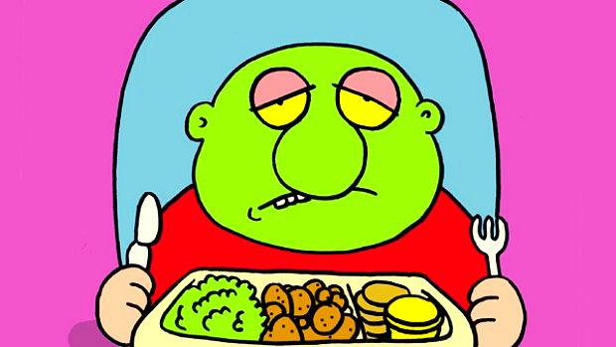
Deepak cooked the meal awfully and so Arun asked Deepak to leave but he tried to please Arun.
Deepak smiled in his most attractive way and Arun could not stop laughing looking at him and so Arun agreed to teach him how to cook.
Arun also agreed to teach him how to add numbers, write a full sentence add money on paper.

Slide 8
Deepak was grateful as he knew that there would be no limit to robbing people once he learned how to read and write.
Deepak used to make him tea in the morning and then go out to buy the groceries for the day.
Deepak also used to steal some rupees from the money that was given to him to buy the groceries every day and Arun knew that he used to steal but did not mind.
Arun used to make money by irregular works and sometimes he used to borrow money.

Slide 9
And the other day, when he had money, he would be lending it to other people and whenever he used to get money, he would go out and celebrate lavishly.
Deepak had many chances to steal as he had the key to the room as well.
But he was surprised with the amount of trust Arun had in him as he had never seen such a trusting person in his life.
This trust thing was preventing him from robbing Arun as Deepak thought that robbing a careless person like Arun didn't make much difference because he might not even notice that he had been robbed and that took out all the fun from the work.

Slide 10
Then he thought of stealing Arun’s money and justified himself that even if he didn't steal money from Arun then also he would waste it on his friends.
Deepak also thought that Arun didn't pay him for the work that he did.
One fine day, Arun received a bundle of notes for his published articles.
He kept the money under his mattress and Deepak happened to notice this.
At midnight, when Arun was fast asleep Deepak woke up and stealthily slipped his hand and stole the money kept under the mattress.
He decides to leave the city by Amritsar Express that departed at 10:30.

Slide 11
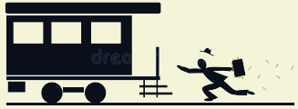
When he reached the station, the train had slowly started moving from the platform.
He could have easily caught the train, but he hesitated and he himself did not know the reason for it.

Slide 12
After the train had left, Deepak was all alone at the train station and was left with no place to sleep at night.
The only person he knew was Arun and he had looted him as well.
He sat on a bench in a park and as it started to rain, he sat down under the clock tower and realized that the notes had also got wet.
He realized that learning how to read and write would help him to get a much more respectable and honest job which would pay him much more than these few hundred rupees

Slide 13
Deepak decided to go back to Arun’s house and the notes had become soggy due to rain, and he kept the money in the same spot from where he retrieved it.
The following day, when he woke up he found Arun was normal as usual.
The young man offered Deepak fifty rupees and said that he had rightfully earned it and he further added that he would pay Hari regularly.

Slide 14
However, when Deepak touched the money, he realized that the money was still damp.
Deepak realized that Arun had come to know about his misdeed but there was no sadness, anger, or guilt in his mind.
On the contrary, Arun promised to teach Deepak how to write full sentences.
After this incident, Deepak was filled with gratitude and respect for Arun and he decided to mend his ways and become a noble human-like Arun.

Slide 15
THANKYOU!!

